Slide 1
CS5590 Applied Programming Series
Web/Cloud/Mobile Programming

Slide 2
Introduction to MongoDB and D3
MongoDB, Data Visualization with D3 (Data-Driven Documents)

Slide 3

Overview
Introduction to MongoDB
Introduction to D3.JS
Importance of D3.JS
Types of data formats used in D3
SVG: Scalable Vector Graphics
CSV
JSON
How to implement D3 inside HTML
How to call methods of D3
Methods available in D3 ( https://github.com/d3/d3/blob/master/API.md)
How to represent JSON data with D3.JS

Slide 4
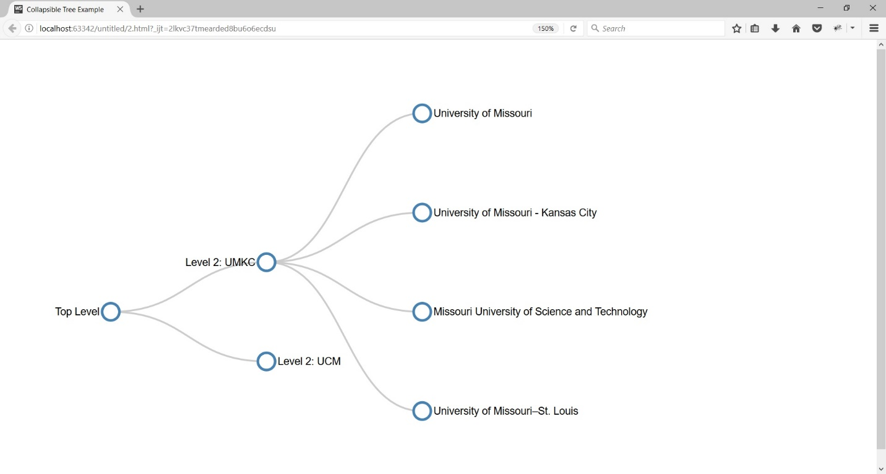
Use Case
Represent the Universities, their branches and departments in that university of a country in tree diagram

Slide 5
Introduction to MongoDB
One of the most popular NoSQL database is MongoDB.
open-source document database that provides high performance, high availability, and automatic scaling
A record in MongoDB is a document, which is a data structure composed of field and value pairs
The values of fields may include other documents, arrays, and arrays of documents
MongoDB documents are similar to JSON objects
Source: https://docs.mongodb.com/

Slide 6
MongoDB with NodeJS
Node.js can be used in database applications
MongoDB can be accessed in local machine
MongoDB can be accessed in cloud through Mongo Lab
Local: Install MongoDB in local https://www.mongodb.com/
Cloud: Create an account in Mongo Lab
Refer the installation PPT
To download MongoDB package: npm install mongodb
Node.js can use this module to manipulate MongoDB databases
Source: https://docs.mongodb.com/

Slide 7
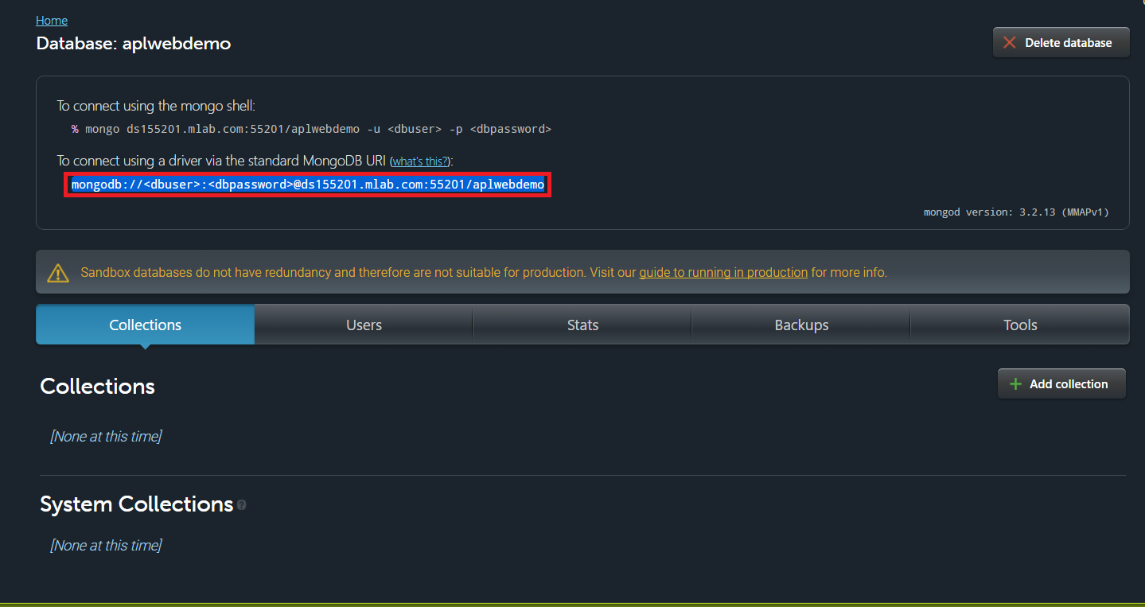
Create the Database - Cloud
Source: https://docs.mongodb.com/

Slide 8
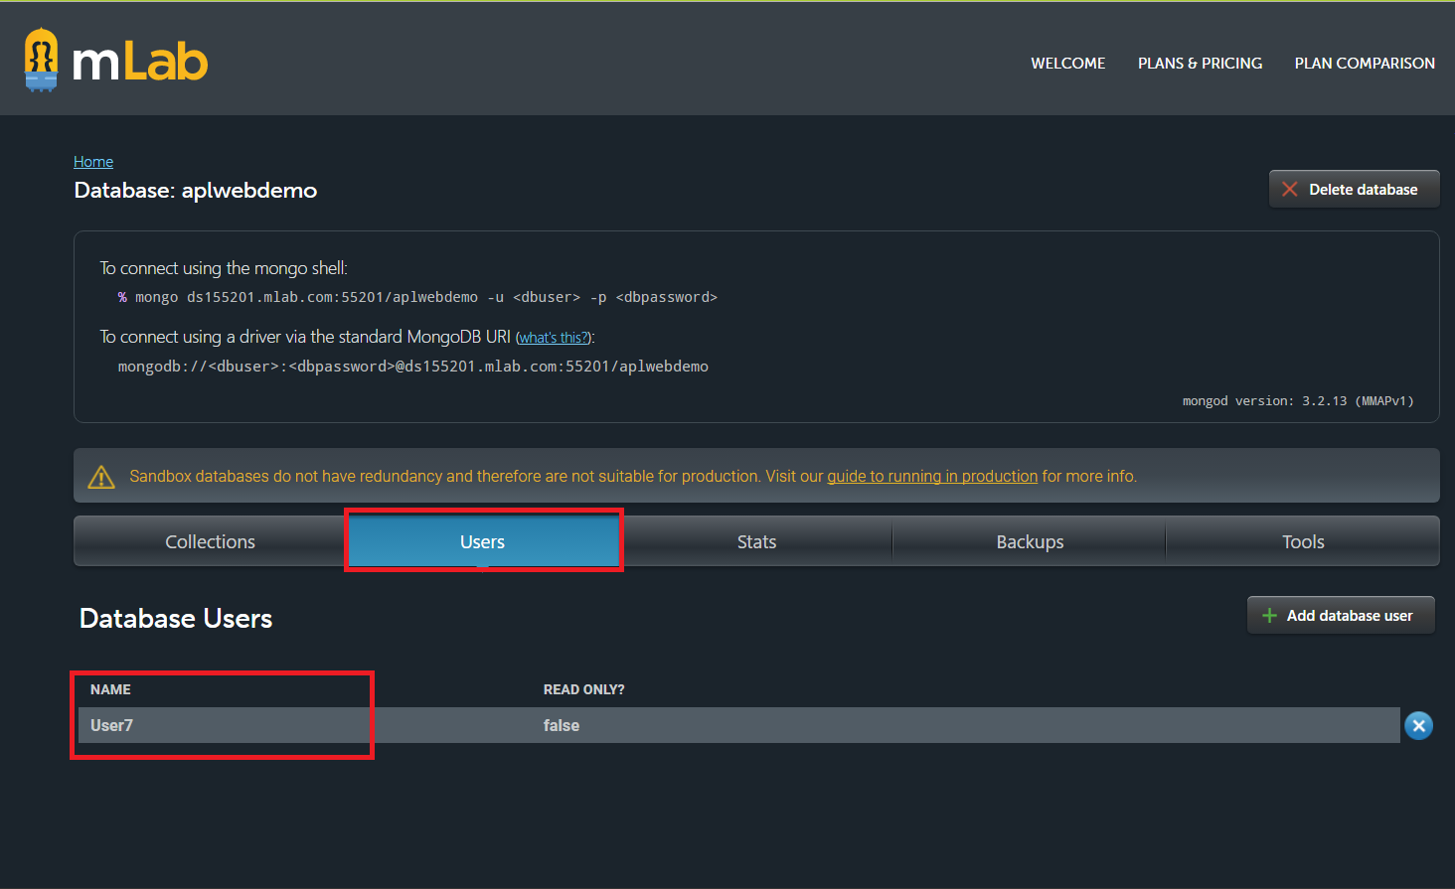
Create the User - Cloud
Source: https://docs.mongodb.com/

Slide 9
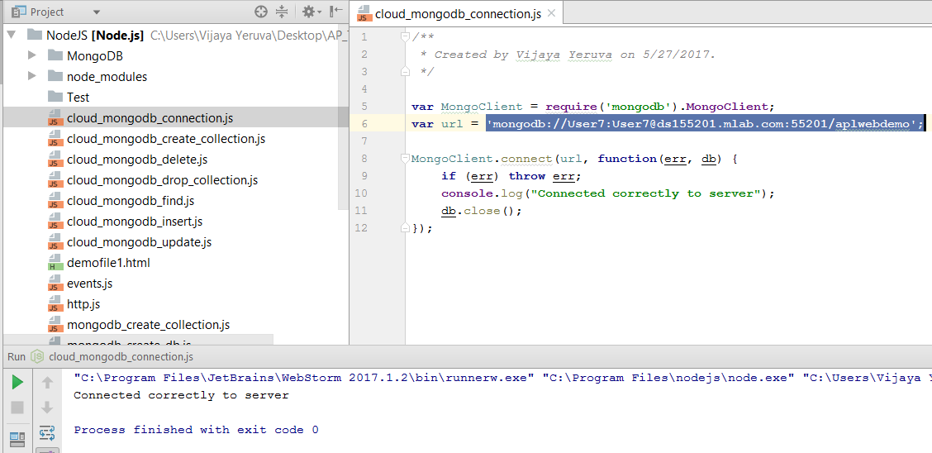
Connect to the Database - Cloud
Source: https://docs.mongodb.com/

Slide 10
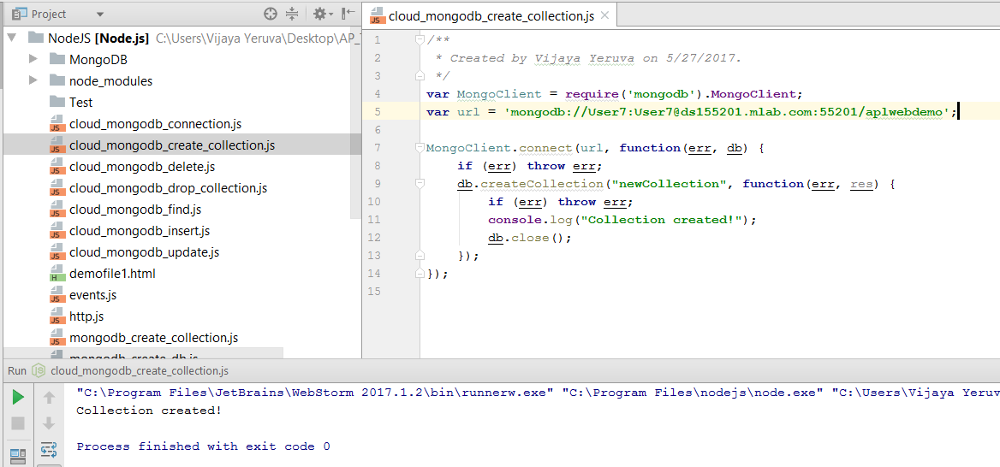
Create the Collection - Cloud
Source: https://docs.mongodb.com/

Slide 11
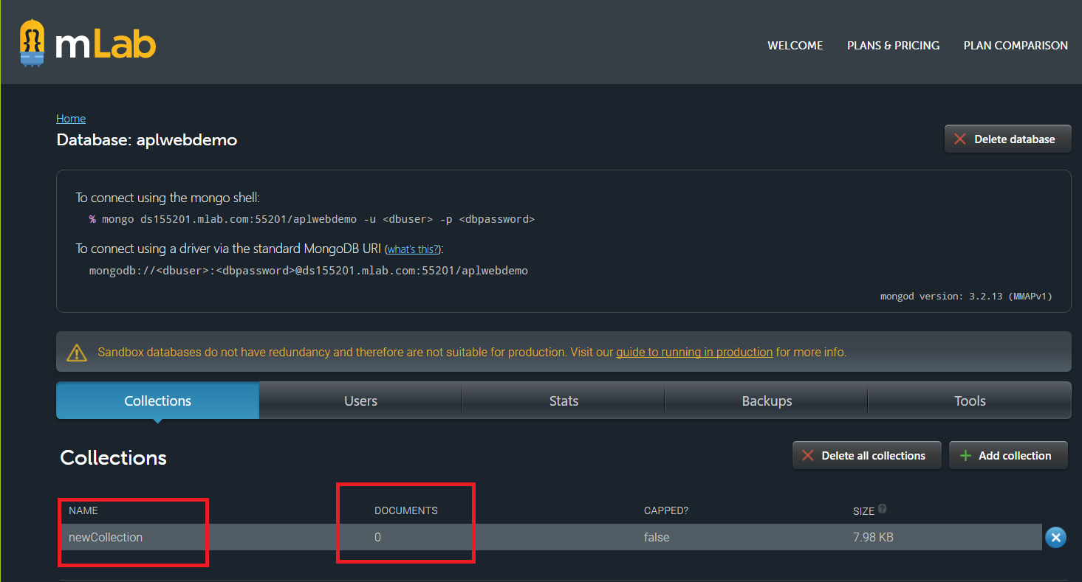
Create the Collection - Cloud
Source: https://docs.mongodb.com/

Slide 12
MongoDB CRUD Operations
Create Operations
Read Operations
Update Operations
Delete Operations
Source: https://docs.mongodb.com/

Slide 13
Create Operations
Create or insert operations add new documents to a collection
If the collection does not currently exist, insert operations will create the collection
MongoDB provides the following methods to insert documents into a collection:
db.collection.insertOne()
db.collection.insertMany()
db.collection.insert()
Source: https://docs.mongodb.com/

Slide 14
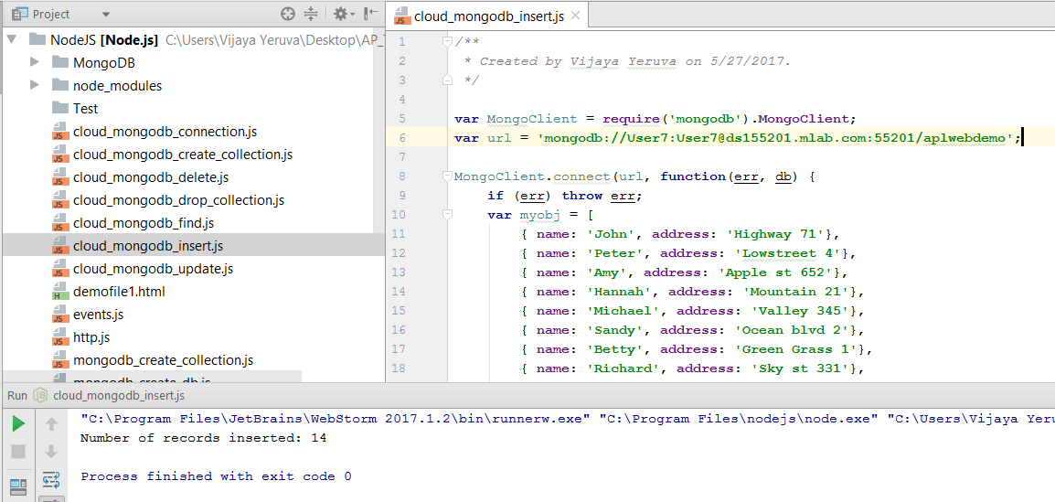
Create Operations - Cloud
Source: https://docs.mongodb.com/

Slide 15
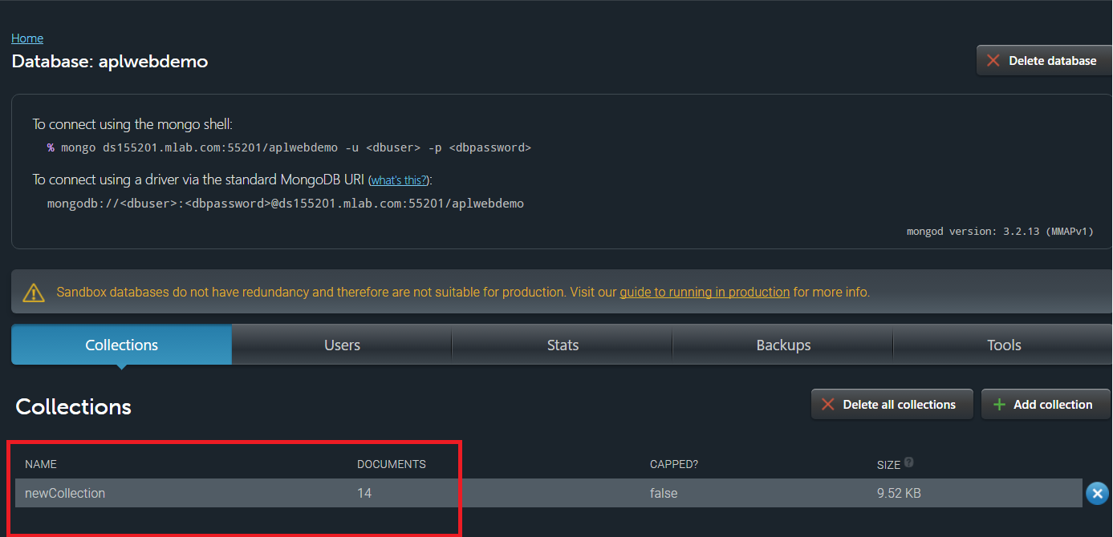
Create Operations
Source: https://docs.mongodb.com/

Slide 16
Read Operations
Read operations retrieves documents from a collection
i.e. queries a collection for documents
MongoDB provides the following methods to read documents from a collection:
db.collection.find()
You can specify query filters or criteria that identify the documents to return
Source: https://docs.mongodb.com/

Slide 17
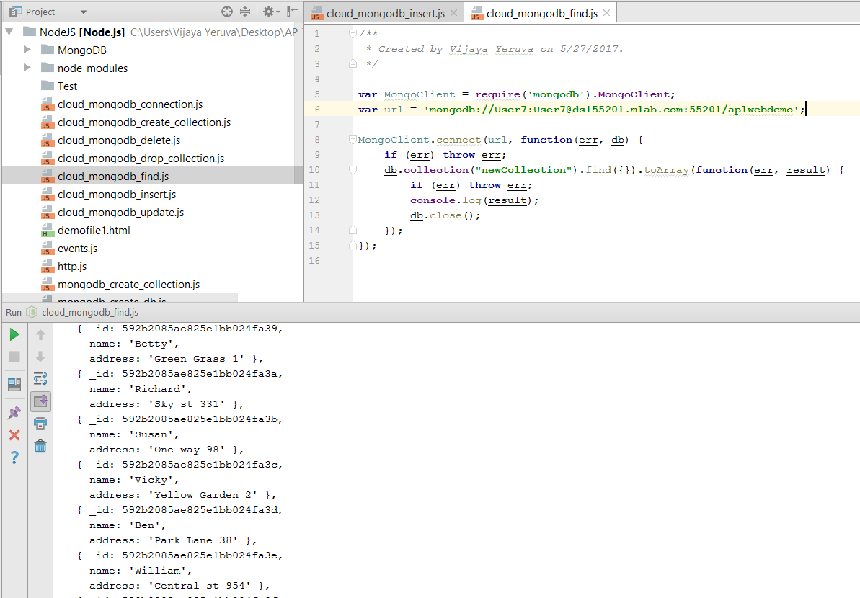
Read Operations
Source: https://docs.mongodb.com/

Slide 18
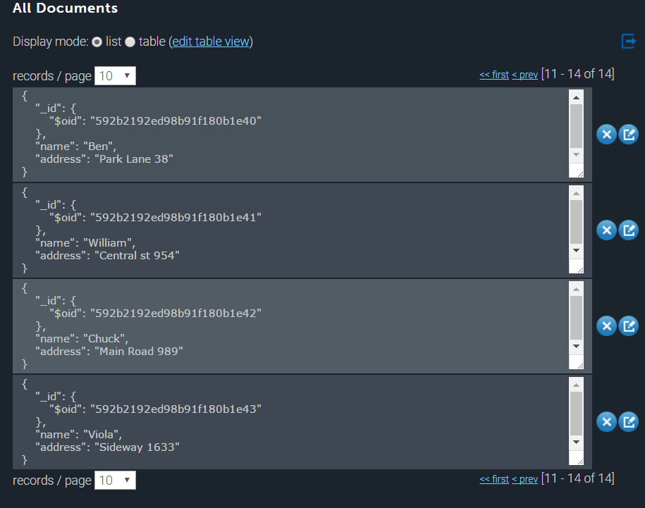
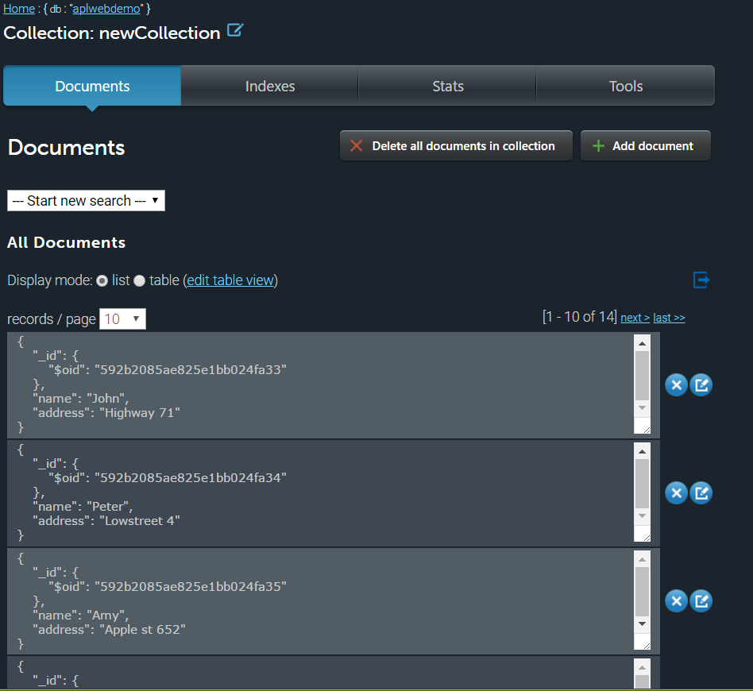
Read Operations

Slide 19
Update Operations
Update operations modify existing documents in a collection
MongoDB provides the following methods to update documents of a collection:
db.collection.update()
db.collection.updateOne()
db.collection.updateMany()
db.collection.replaceOne()
You can specify criteria, or filters, that identify the documents to update
These filters use the same syntax as read operations
Source: https://docs.mongodb.com/

Slide 20
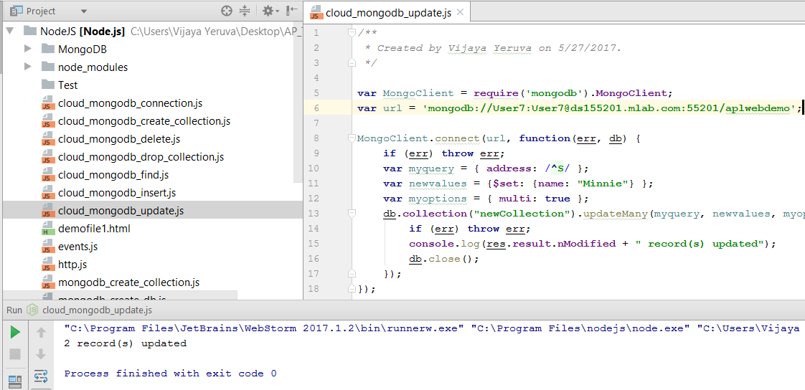
Update Operations
Source: https://docs.mongodb.com/

Slide 21
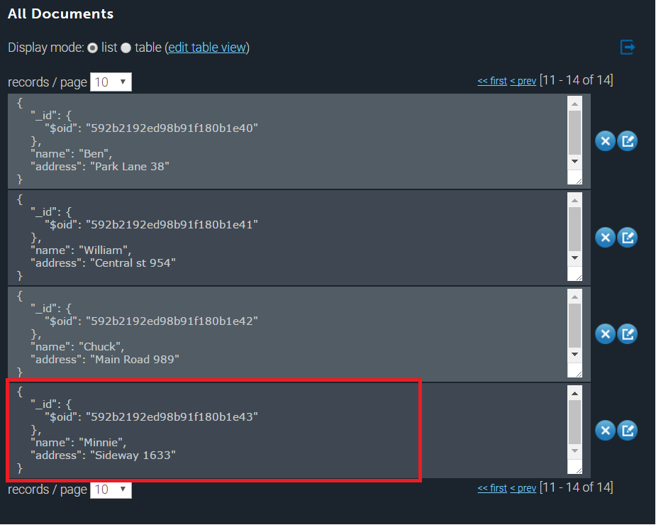
Update Operations
Source: https://docs.mongodb.com/

Slide 22
Delete Operations
Delete operations remove documents from a collection
MongoDB provides the following methods to delete documents of a collection:
db.collection.deleteOne()
db.collection.deleteMany()
db.collection.delete()
You can specify criteria, or filters, that identify the documents to remove
These filters use the same syntax as read operations
Source: https://docs.mongodb.com/

Slide 23
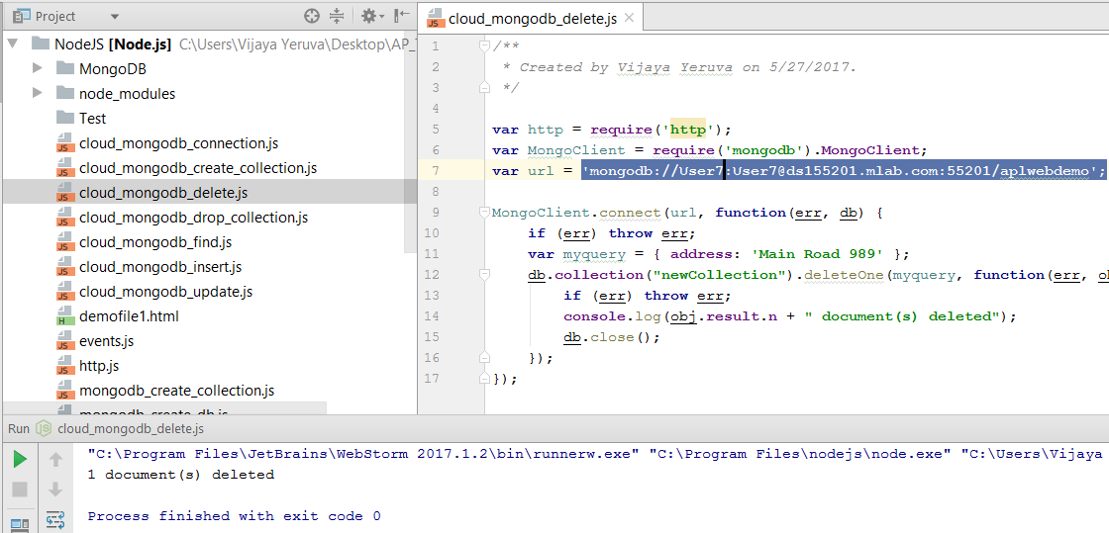
Delete Operations
Source: https://docs.mongodb.com/

Slide 24
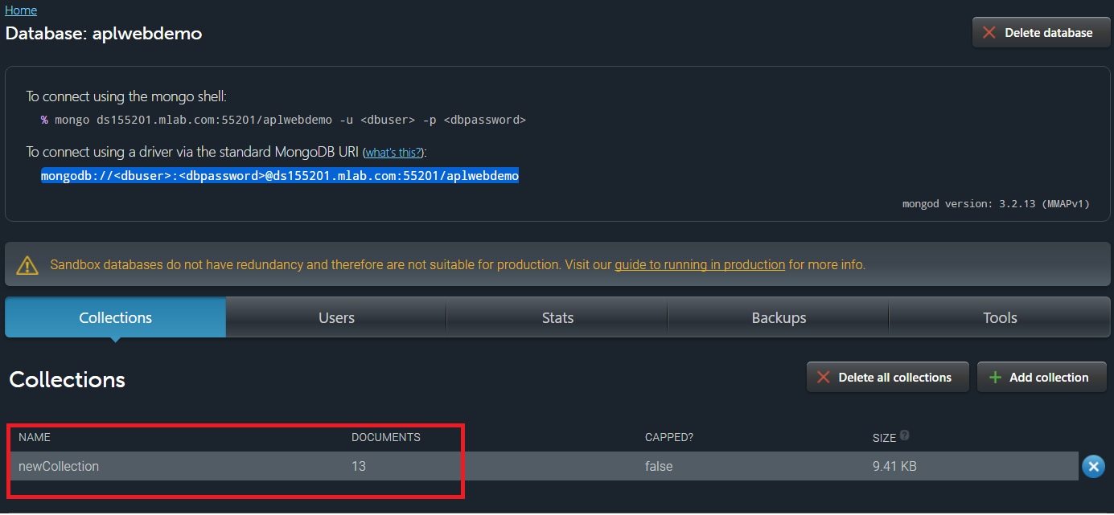
Delete Operations
Source: https://docs.mongodb.com/

Slide 25
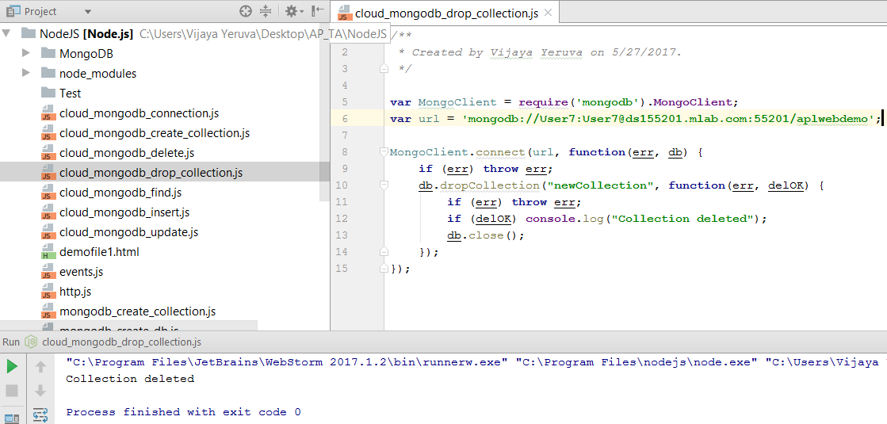
Drop the Collection
Source: https://docs.mongodb.com/

Slide 26
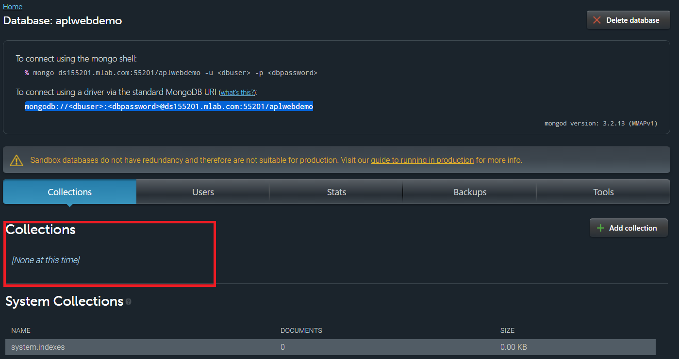
Drop the Collection
Source: https://docs.mongodb.com/

Slide 27
Start the MongoDB Server
Command: mongod --dbpath “path where to initiate DB”
Eg: mongod --dbpath “C:\Users\Vijaya\Desktop\AP_Web\NodeJS\MongoDB”
To create a database in MongoDB, start by creating a MongoClient object, then specify a connection URL with the correct ip address and the name of the database you want to create
MongoDB will create the database if it does not exist, and make a connection to it
Source: https://docs.mongodb.com/

Slide 28
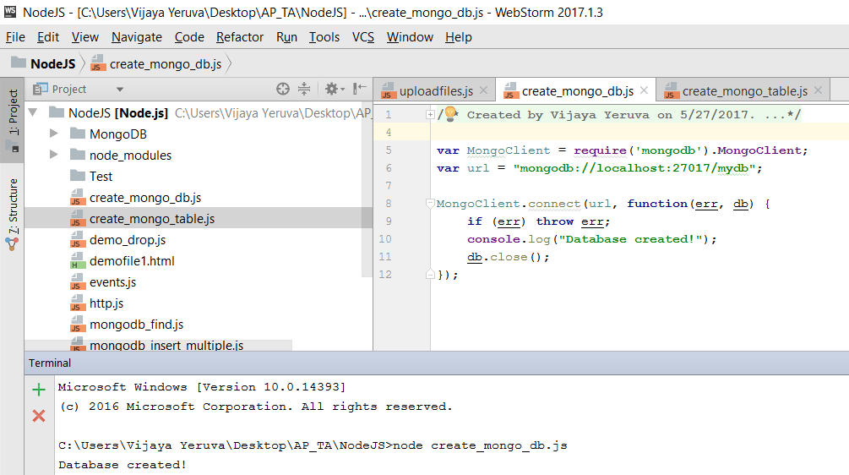
Create the Database
Source: https://docs.mongodb.com/

Slide 29
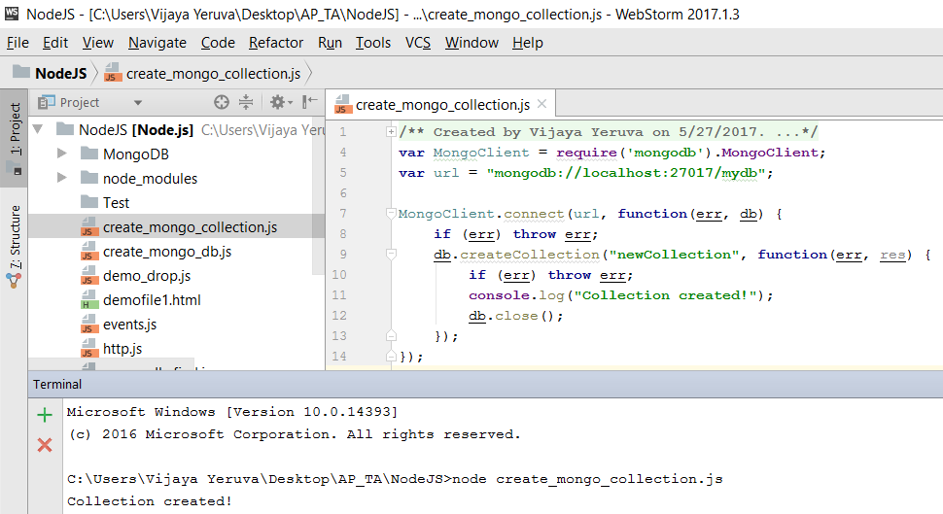
Create the Collection
Source: https://docs.mongodb.com/

Slide 30
MongoDB CRUD Operations
Create Operations
Read Operations
Update Operations
Delete Operations
Source: https://docs.mongodb.com/

Slide 31
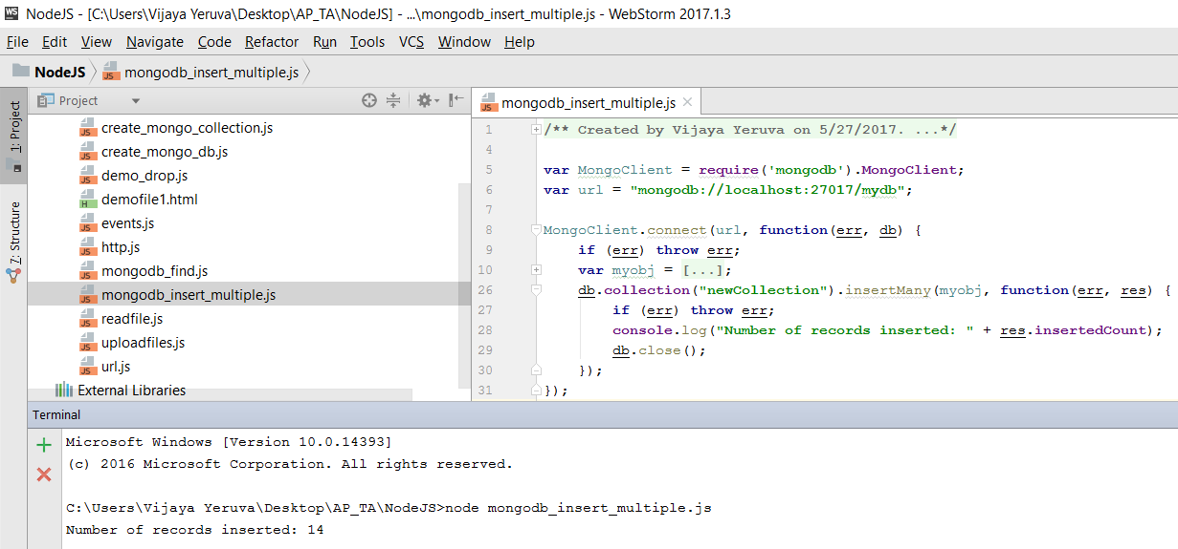
Create Operations
Source: https://docs.mongodb.com/

Slide 32
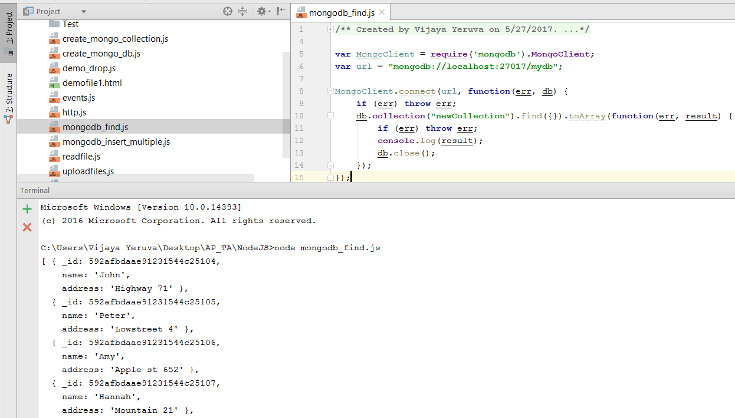
Read Operations
Source: https://docs.mongodb.com/

Slide 33
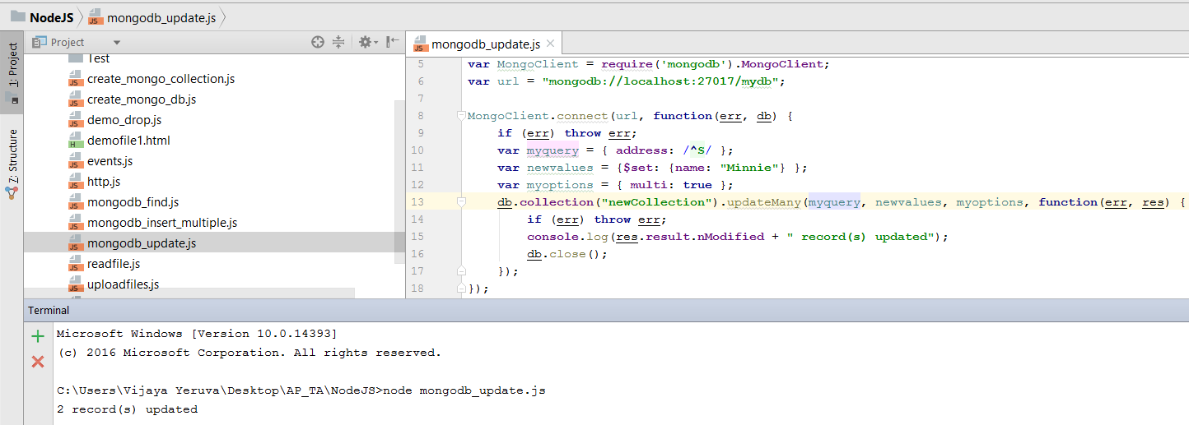
Update Operations
Source: https://docs.mongodb.com/

Slide 34
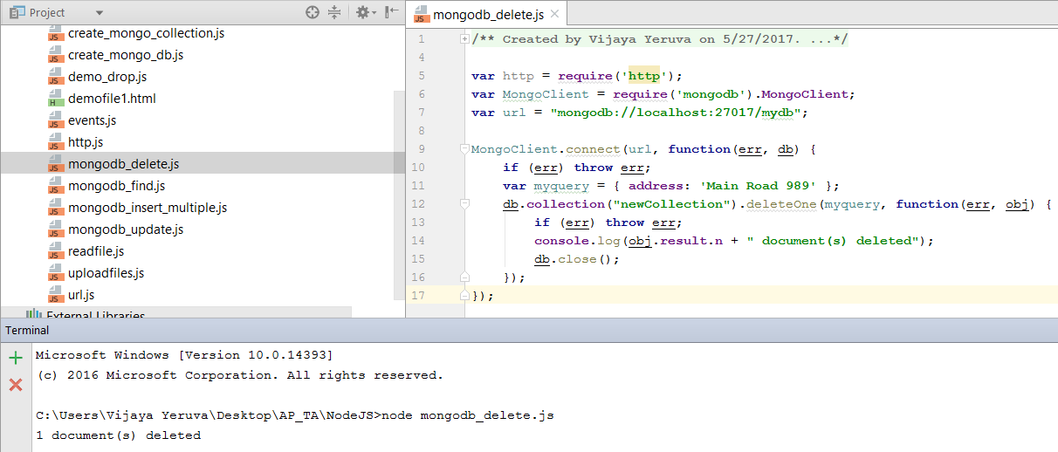
Delete Operations
Source: https://docs.mongodb.com/

Slide 35
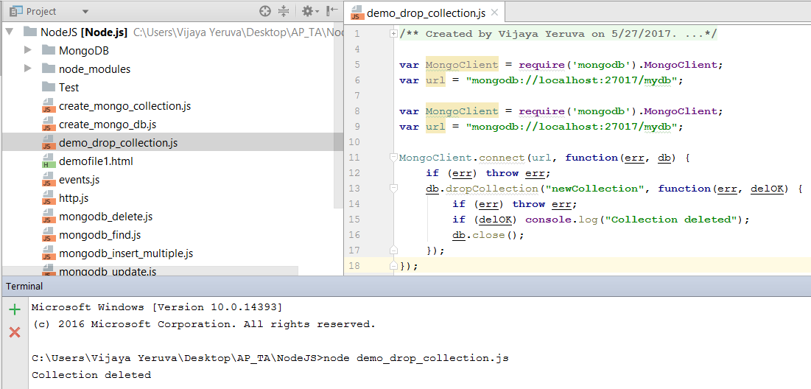
Drop the Collection
Source: https://docs.mongodb.com/

Slide 36
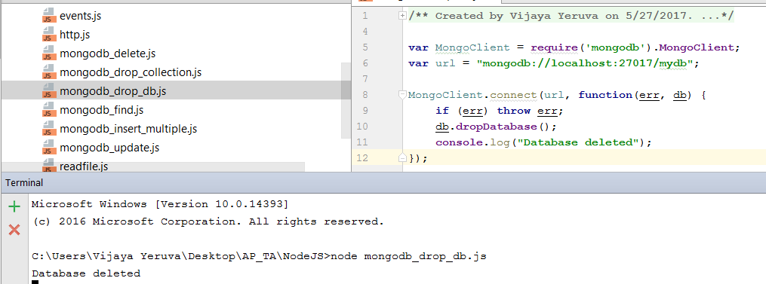
Drop the Database
Source: https://docs.mongodb.com/

Slide 37
Why Data Visualizations?
A proverb is a simple and concrete saying popularly known and revered, which expresses a truth, based on common sense or the practical experience of humanity. The proverb "A picture is worth 1000 words" is one you have probably heard more than once.
Source: https://d3js.org/

Slide 38
What is D3 (Data-Driven Documents)?
D3.js is a JavaScript library for manipulating documents based on data.
D3 helps you bring data to life using HTML, SVG, and CSS.
D3’s emphasis on web standards gives you the full capabilities of modern browsers without tying yourself to a proprietary framework, combining powerful visualization components and a data-driven approach to DOM manipulation.
Source: https://d3js.org/

Slide 39
Why D3?
D3 allows you to bind arbitrary data to a Document Object Model (DOM), and then apply data-driven transformations to the document.
For example, you can use D3 to generate an HTML table from an array of numbers.
Or, use the same data to create an interactive SVG bar chart with smooth transitions and interaction.
D3 is extremely fast, supporting large datasets and dynamic behaviors for interaction and animation. D3’s functional style allows code reuse through a diverse collection of official and community-developed modules.
Source: https://d3js.org/

Slide 40
Types of data formats used in D3
SVG: Scalable Vector Graphics
an XMLHttpRequest
a text file
a JSON blob
an HTML document fragment
an XML document fragment
a comma-separated values (CSV) file
a tab-separated values (TSV) file
Source: https://d3js.org/

Slide 41
Implementation of D3 in HTML
Embedded within an HTML webpage, the JavaScript D3.js library uses pre-built JavaScript functions to select elements
To link directly to the latest release, insert below tags in html page:
<script src="https://d3js.org/d3.v4.min.js"></script>
Or, it can be download the latest version (4.9.1) here:
https://github.com/d3/d3/releases/download/v4.9.1/d3.zip
Source: https://d3js.org/

Slide 42
Importance of D3
For example, to change the text color of paragraph elements without D3:
var paragraphs = document.getElementsByTagName("p");
for (var i = 0; i < paragraphs.length; i++) {
var paragraph = paragraphs.item(i);
paragraph.style.setProperty("color", "white", null);
}
D3 employs a declarative approach, operating on arbitrary sets of nodes called selections. We can rewrite the above loop as:
d3.selectAll("p").style("color", "white");
Source: https://d3js.org/

Slide 43
The Data Visualization Process
Acquire
Parse
Filter
Mine
Represent
Refine
Interact
Source: https://d3js.org/

Slide 44
Technical Principles of D3
Selections
Transitions
Data-binding
Source: https://d3js.org/

Slide 45
How to use JSON data with D3
employees.json
[{
"name": "Vijaya",
"title": "TA",
"Subject": "Web"
}, {
"name": "Karthik",
"title": "TA",
"Subject": "Web"
}
]
d3.json("/data/employees.json", function (data) {
console.log(data[0]);
});
Out put: { name: "Vijaya", title: "TA", Subject: "Web“ }
Source: https://d3js.org/

Slide 46
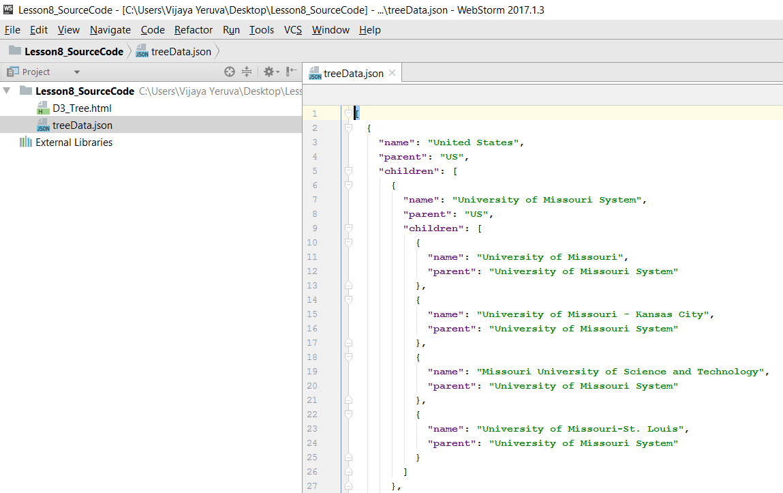
How to use JSON data with D3
Source: https://d3js.org/

Slide 47
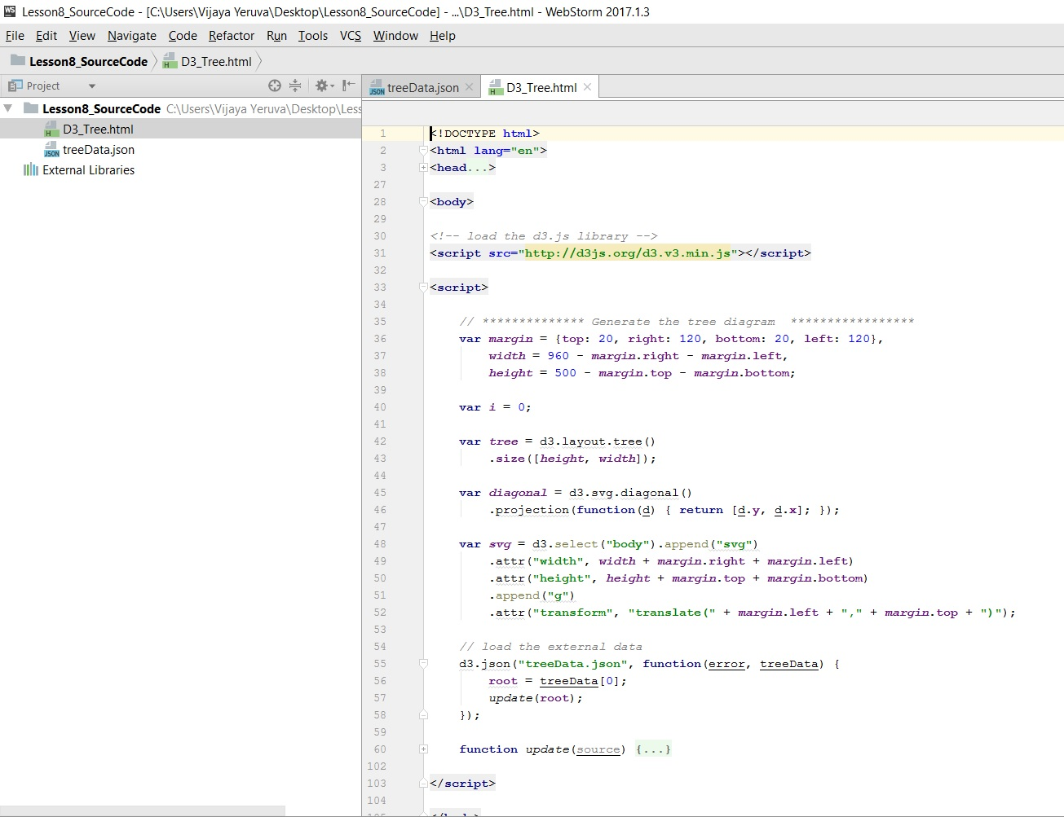
How to use JSON data with D3
Source: https://d3js.org/

Slide 48
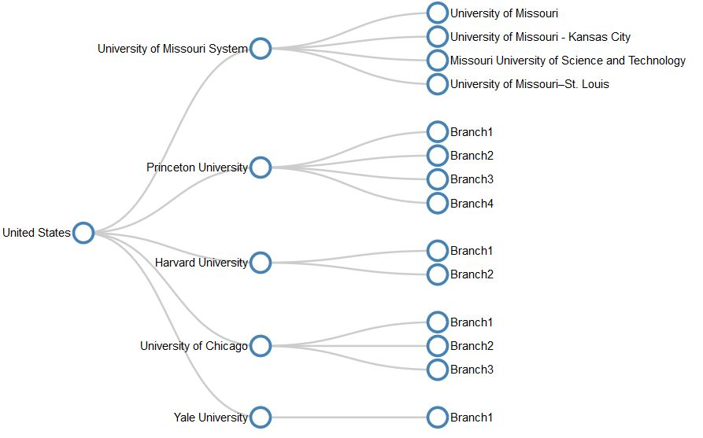
How to use JSON data with D3
Source: https://d3js.org/

Slide 49
References
https://en.wikipedia.org/wiki/D3.js
https://d3js.org/
https://www.udacity.com/course/data-visualization-and-d3js--ud507
https://github.com/d3/d3/
https://www.dashingd3js.com/table-of-contents

Slide 50
In class exercise
In above(explained in class) use case, Implement the Drag and Drop, Zoomable, Panning, Collapsible Tree with auto-sizing
Reference:
http://bl.ocks.org/sgruhier/1d692762f8328a2c9957
https://bl.ocks.org/mbostock/4339083
http://bl.ocks.org/robschmuecker/7880033
http://bl.ocks.org/tizon9804/8540d89cc896927d35030cad2508324d

Slide 51
Feedback
Please don't forget to submit your feedback after the class. This helps a lot in increasing effectiveness of the course.
Use following link to submit your feedback: https://goo.gl/forms/YKYg28wsHo7OnOa13

